Slide 1
Language Documentation
Week 1: Software
Claire Bowern
Yale University
LSA Summer Institute: 2013

Slide 2
general principles

Slide 3
General Principles
“Interoperability”: aka “never need to retype!”
Ideally, it should be possible to move data easily and seamlessly between programs (or use a single program for everything).
In reality…
The ‘single program’ solution produces unacceptable compromises (bloatware, can’t handle all data types, etc)
Multiple programs require the programmers to agree on data standards, which will never happen.
Several programs now solve *most* of the problems.
Workarounds are possible but require care.

Slide 4
Choosing software
Ease of use with your data
How long will it take to learn the program? Is it worth it?
Can you type your language easily (e.g. right-to-left input, non-Ascii symbols, etc)?
Can you keep track of all the information you need to?
Does the program work well within your workflow?
Can you search your data easily?
Can you get your data into and out of the program? Can you back it up?
Can other people use it? Do you need to share your data? Do you need to have more than one person working on your data?

Slide 5
Software Types
Today:
Notes:
Describing my workflow and software I use (there are other programs and I’ll mention them, but there’s no time to talk about all of them)

Slide 6
Software types
Each point of the workflow (i.e. each task in the documentation) will need certain software
Creation [and editing]
Annotation [and analysis]
Preservation
Dissemination [and publication]

Slide 7
Overview of programs by function
Organize field notes and recordings
Process recordings (audio and video)
Transcription
Corpus creation
Parsing/interlinearization
Analysis/tagging
Lexicon/dictionary making
Writing other secondary materials
journal articles
reference grammar, dissertation
community materials
Web publication
Backup tools
Notes:
you can see why a one-size fits all program is hard to come by.

Slide 8
Organizing field notes/recordings
Some way of recording what is on each recording, what you have in the collection
Needed for archiving
*Very* helpful for when you’re working with your collection.
Database program.
Filemaker, Bento
Access
Base, etc
Other options:
spreadsheet program like Excel or Base.
Notetaking software such as Evernote
Metadata tool such as IMDI
iTunes
Metadata extractor that takes collections and lets you annotate the file names.

Slide 9
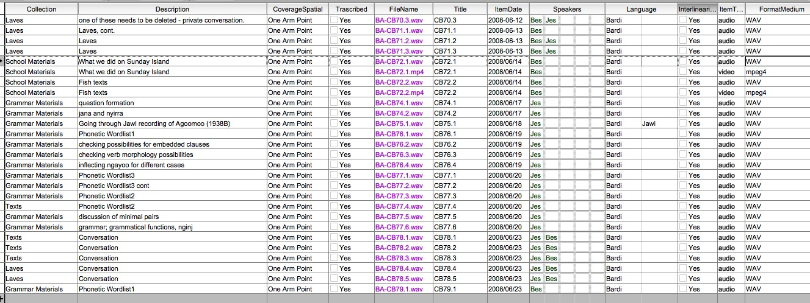
Sample Filemaker db

Slide 10
Not recommended
Using the file name annotation in Apple finder, etc

Slide 11
Information to collect
Session info
who, what, when, where, how
language
Speaker info
demographic info
Media info
sampling rate, etc
Material status info
access restrictions, processing comments, links

Slide 12
Processing recordings
Audio and video editing software.
Resampling
changing format (e.g. wav > mp3)
clipping
Audacity is popular.
Praat can also do all the needed things (but can be cumbersome)
Quicktime or VLC for video conversions and clipping
(other video editing suites)

Slide 13
Transcription
Elan (de facto standard?) (http://tla.mpi.nl/tools/tla-tools/elan/)
Transcriber (http://transag.sourceforge.net/)
Transana (http://www.transana.org/)
Clan (used for the Childes database and talkbank) (http://childes.psy.cmu.edu/clan/)
Time-aligned transcripts should be mandatory!

Slide 14
Elan example

Slide 15
Corpus creation, management, and searching
aka: some way to organize your electronic fieldnotes and transcripts.
Toolbox, Elan
TLex has a corpus option, based on text files
TextStat (http://neon.niederlandistik.fu-berlin.de/en/textstat/)

Slide 16
Parsing/Interlinearization
Most commonly used platforms:
Toolbox
Flex
See http://tla.mpi.nl/tools2/tooltype/interlinearization/ for a great list of options.
Elan can be set up to parse semi-manually.
Lingsync (https://www.lingsync.org)

Slide 17
Toolbox pros and cons
works on text files with minimal markup
well established in the field
can build lexicon
basic corpus tools
can interface with Elan
small footprint
files are sharable through e.g. dropbox
flat file database structure
Elan interface requires some hand-processing of texts (or knowledge of python)
parser doesn’t work well for complex morphology, tone
no ‘on the fly’ update
mac use is fiddly

Slide 18
Flex Pros and Cons
Structured data entry
on the fly update
built-in analysis libraries (e.g. dictionary topics, morpheme types)
Slow! Bloatware!
Windows only
File sharing difficult
built-in analysis libraries encourage paint-by-numbers documentation.

Slide 19
Summary: Data analysis
(Depends on the data and task)
Praat for phonetics (www.praat.org)
Corpus program, concordance generator (*very* useful!)
Toolbox
FLEx
TextStat
Some way of keeping track of notes, analyses, etc
e.g. Evernote
http://en.wikipedia.org/wiki/Comparison_of_notetaking_software has a very long list of options.
Tiddlywiki
(Text editor, e.g. Textwrangler, NotePad++, etc)

Slide 20
Dictionary
Lexique Pro (www.lexiquepro.com)
Toolbox or FLEx
For combining with texts, parsing, etc
Kirrkirr
Great for presenting final dictionaries
Not an editing program
TshwaneLex (tschwanedje.com)
For editing and printing/sharing dictionaries (not free)
WeSay (wesay.org)
(Lexus)

Slide 21
Pros and Cons: Lexique
Widely used
Can edit entries easily
Can add pictures and sound
Can sort by meaning
English or Language list
Easy to update
Can publish on internet
Can use with Toolbox
Tends to crash
Doesn’t always work
Limited display
No fuzzy searching
Linking is temperamental
PC only
hard to have multiple users
hard to create fully bilingual dictionaries

Slide 22
Pros and Cons: TshwaneLex
Flexible/customizable
Reliable
PC and Mac
Can include images and sound
Multiple exports
Can import corpus data
can create fully bilingual dictionaries
not free
steep learning curve
Mac version has some bugs
can’t use same file for interlinearization

Slide 23
Pros and Cons: FLEx
Powerful
Free
Can integrate with written corpus
Can export to web, lexique, etc
PC only
Clunky, slow
Can’t integrate sound file transcriptions
Only one dictionary model
Lots of assumptions about linguistics built in
Difficult to export in multiple formats (via \ code)

Slide 24
Software suggestions
Toolbox (or Flex or Lexique)
TshwaneLex if making a stand-alone dictionary
Transcription software (e.g. Elan)
a text editor (e.g. textwrangler [osx], edit pad [pc], etc)
Concordance program (textstat, monoconc, etc)

Slide 25
Sample workflow
Transcribe with Elan
Export clips to Praat using sendpraat
preliminary annotation in Elan
Export to Toolbox
interlinearize
compile lexical materials
(annotate for analysis within file)
Reimport transcripts to Elan
Use Elan for corpus search
Export to web via CuPed
Pros:
Relatively streamlined
Requires few programs
Exploits advantages of each program
can be done offline
portable/can be backed up easily
flexible to export to other formats if needed
Cons:
potential version control issues

Slide 26
What about using Word & Excel?
Pros:
No learning curve
May be the most available software
May already have data
Cons:
Proprietary
Designed for business, not for dictionary writing
Word – no explicit structure
Word – hard to search
Excel – “flat” format, not relational
Multiple people can’t work on same document

Slide 27
Disseminating results
Many possibilities, depending on the type of results:
Word processing software for journal articles, dissertation, etc:
Word, LyX, (Xe)LaTeX
Desktop publishing software for school books, etc (e.g. indesign)
CuPED for sharing Elan transcripts.
Web editing software
App authoring software
Wunderkammer for mobile phone dictionaries
Google earth for site mapping
etc.

Slide 28
Backing up your data
Cloud solutions
Dropbox
Sugarsync
Google Drive
mac.com
etc
University backup services
Physical media
portable hard drive
DVDs
-> Send to archive

Slide 29
Cloud services
Pros:
Cheap (often free)
“set and forget”: can work with existing directory structures
Cons:
Requires internet connection
Might be difficult if you’re backing up audio and video
Not necessarily secure
Syncing issues: easy to overwrite data, not always easy to get it back.
If something happens to the service provider, you’re screwed.

Slide 30
Physical media
Pros
Solves many of the ‘cons’ of cloud services
Cons
Unknown durability
time-consuming
Doesn’t solve the problem of physical destruction of data if kept in the same place as your main working copies!

Slide 31
Archiving
Archive your original recordings as soon as possible!
You don’t need to finish analysis before archiving part of the collection.
More about archiving in week 4.

Slide 32
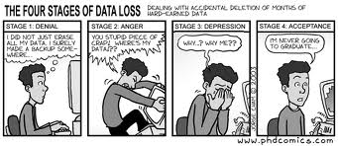
Recommendations
Cloud based back up for analysis files, frequently access files.
Have at least one (ideally two or more) physical backups of all your data, stored in different places (e.g. one at home, one with your parents, one in the community)
Archive materials as soon as possible.
Sound like overkill?

Slide 33
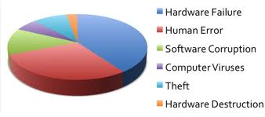
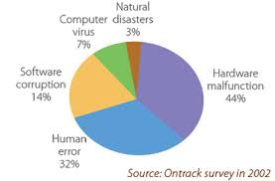
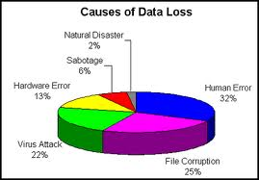
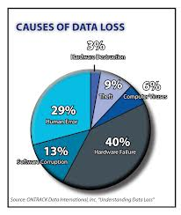
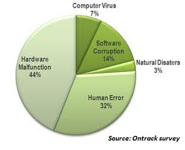
Causes of Data Loss

