Slide 1
Language Documentation
Week 4: Archiving
Claire Bowern
Yale University
LSA Summer Institute: 2013

Slide 2
Why archive?
Safety: to ensure durability of materials
Access: to ensure that relevant stakeholders have access to the materials

Slide 3
Where to archive?
Many options these days!
University archive (yours or someone else’s)
Local (community) archives
Regional language archives
ELAR
NB: putting materials on the web isn’t archiving.

Slide 4
Archives
Online Archives:
AILLA (for Latin America): http://www.ailla.utexas.org/site/welcome.html
AIATSIS (for Australia): mura.aiatsis.gov.au
British Library (explorer and missionary documents: Commonwealth countries)
National (US) Archives:
Smithsonian Institution: http://si.edu
Library of Congress: http://www.loc.gov/index.html
American Philosophical Society: http://www.amphilsoc.org/
University Archives:
U Penn, Harvard, Cornell, Yale, Chicago (and others) all have large manuscript holdings
UC Berkeley: Bancroft Library; Survey of Californian Indian languages
Tribal Archives
Local Historical Societies
Local Churches
Notes:
If we have time, we can show some of these web sites.

Slide 5
Archives
Some archives require a visit in person, others can help you through email/phone.
Always ask! The archivists are there to help.
Try to be specific with questions.
Many archives need appointments in advance.
Some have material repatriation programs.

Slide 6
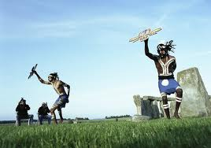
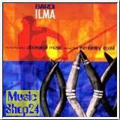
Within the community
Individuals might have language materials:
diaries
stories
tapes
wordlists
copies of notes from researchers

Slide 7
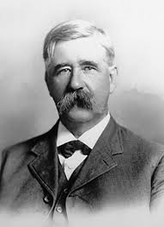
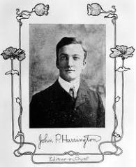
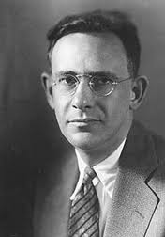
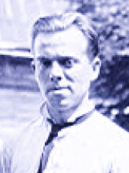
Have linguists or anthropologists worked on the language?
Try to find out if community outsiders have worked on the language
E.g. (US) J P Harrington, Edward Sapir, C Hart Merriam, F.G. Speck, etc.
Ask around if people remember linguists working on the language.
Contact your local university.
Post a question on the ILAT list. http://linguistlist.org/lists/get-list-detail.cfm?List=2135

Slide 8
On the web
google.com
Google Scholar: scholar.google.com
Web archives (see above)
What to search for?
Language name
e.g. Onondaga language, Cherokee language (or Tsalagi language)
Words in the language
e.g. miinimbi (Bardi for ‘whale’)
Names of people who’ve worked on the language
e.g. Oneida Karin Michelson

Slide 9
Legal issues
Archiving is a contract between the linguist and the institution.
Who has the right to archive the materials (not straightforward to archive another’s materials)?
Who can specify the access protocols?
What happens if there’s disagreement about the decisions?
Responsibilities of archive [conservation, etc]
Responsibilities of linguist
(see http://www.hrelp.org/archive/depositors/depositform/ELAR_Deposit_012PR.pdf)
*I’m not a lawyer…

Slide 10
Data restrictions
Many archives allow holdings to be restricted.
Who gets to view?
Who gets to say if it’s ok for someone to view?
Why?
sensitive information
to allow the linguist time to publish
community wishes

Slide 11
What you’ll need
Metadata!
List of materials
Materials themselves, in archival format
Materials should be organized.
Any restrictions should be clearly labeled.

Slide 12
What to archive?
Recordings
Metadata
Transcripts
Metadata
Stimuli? (or references to them)
Analysis notes
Publications
Maps
Photos?

Slide 13
Archival formats
Digital data are hard to archive!
Many formats
Most media is not designed for long-term storage
Buzzard-Welcher (2007), Simons (2004): An archival format has “LOTS” of good qualities:
Lossless
Open Standard
Transparent
Supported by multiple vendors

Slide 14
Examples
http://depts.washington.edu/wll2/
http://qenaga.org/archive/browse-1.cfm?format=audio
http://www.hrelp.org/archive/
note especially: http://www.hrelp.org/archive/depositors/index.html

