Slide 1
Language Documentation
Week 4: Lexicon
Claire Bowern
Yale University
LSA Summer Institute: 2013

Slide 2
What is a dictionary?

Slide 3
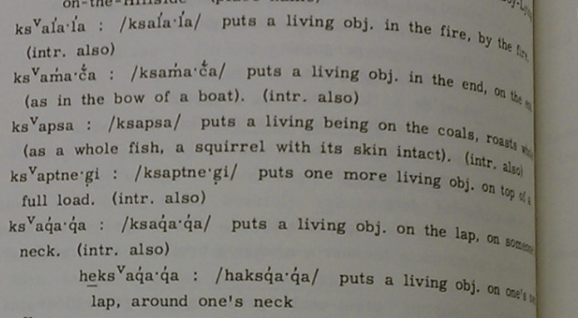
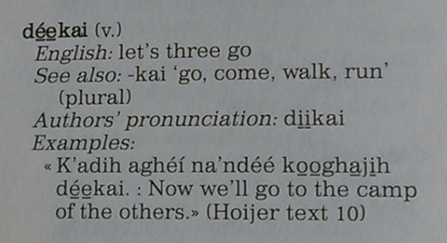
What is a dictionary?
Collection of words and their meanings.
Snapshot of the language through its words.
But, a dictionary can be much more than that:
Klamath
Lakota
Notes:
but this is very broad, and covers a lot of different potential books, sites, etc: Ekegusii prsentation yesterday gave a good illustration of this (‘dictionary’, but also a repository of other information collected in the process of language documentation.

Slide 4
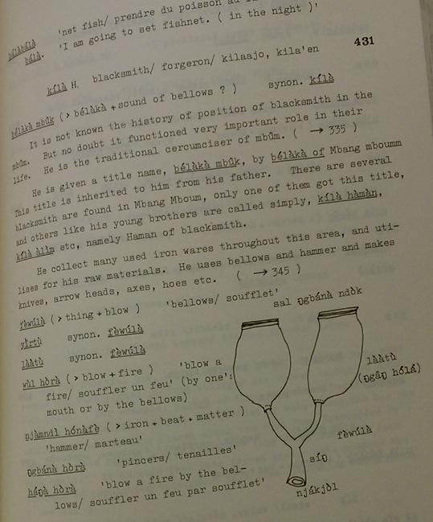
Dictionaries store information about culture
e.g cultural knowledge in definitions
how a language/people categorize the world around them
Mbum

Slide 5
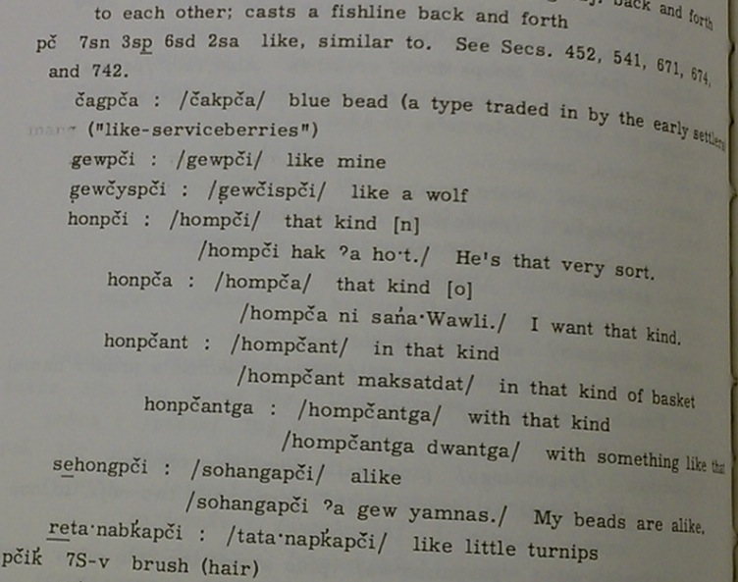
Dictionaries store information about grammar
Example sentences: how to use words (http://www.lifeprint.com/dictionary.htm)
Ways to form words (ways in which words are related to one another)
Klamath

Slide 6
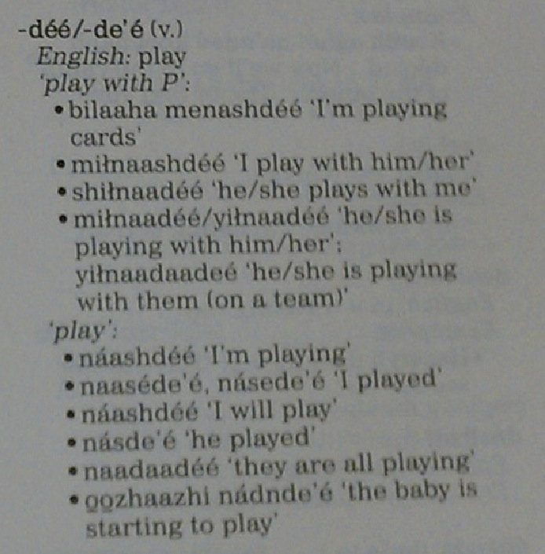
Grammar (cont)
Apache paradigms

Slide 7
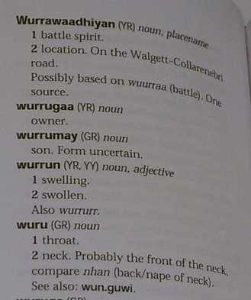
Dictionaries can store information about society
Who uses certain words
Place names
The connotations of words for different groups
Gamilaraay

Slide 8
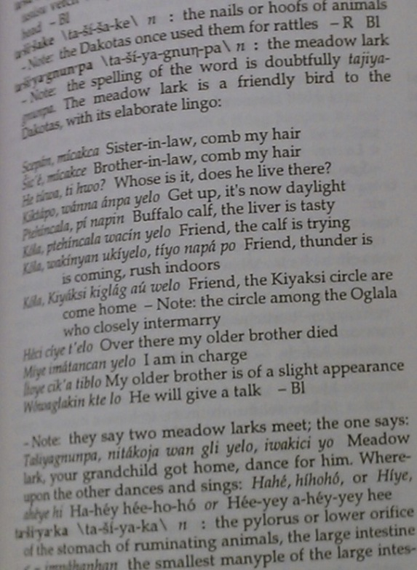
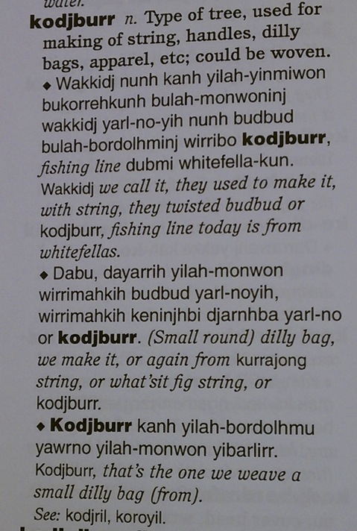
Dictionaries store information about the world around us
Flora and fauna names, descriptions, usage
Dalabon
Lakota
Notes:
Kennedy’s point yesterday: did a dictionary/encyclopedia as a way to store information that the dictionary contributors were sharing, not only about the language, but about their lives and culture.

Slide 9
Why make a dictionary?

Slide 10
Why make a dictionary?
Good way to organize language material in general (for languages with lots of morphology in particular; e.g. examples for morpheme senses, allomorphy, etc)
Klamath
Notes:
Good linguistic reasons as part of language documentation

Slide 11
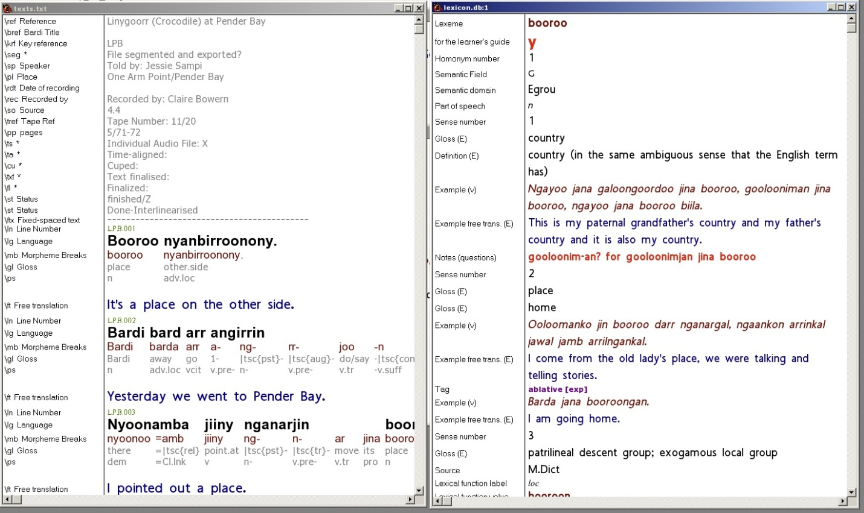
Why make a dictionary?
*Very* useful to have a list of words in your corpus
useful for studying phonology (e.g. phonotactics), morphology, etc
can use as the basis for interlinearizing sentence data
E.g. Toolbox takes words from a dictionary and breaks down sentence data into word pieces

Slide 12
Why make a dictionary?
It’s a useful community end-product: that’s what everyone wants.
It’s a way to organize cultural and other non-linguistic material
E.g. information about items under their names.
It can point out the gaps in understanding of the language and culture
E.g. plant and animal names
E.g. grammar (so can this verb really take an object?)
E.g. semantics (prototypical meaning/extended meaning)

Slide 13
Types of dictionaries

Slide 14
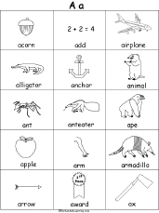
Types of dictionaries
Dictionaries come in many shapes and sizes
wordlists
topical dictionaries or wordlists (e.g. ethnobotany, body parts, spelling books)
reference works
Picture dictionaries
Dictionaries come in many arrangements
Orthographically arranged (e.g. Alphabetic/syllabic/radical)
Arranged by root/stem (esp for polysynthetic languages)
Semantically arranged

Slide 15
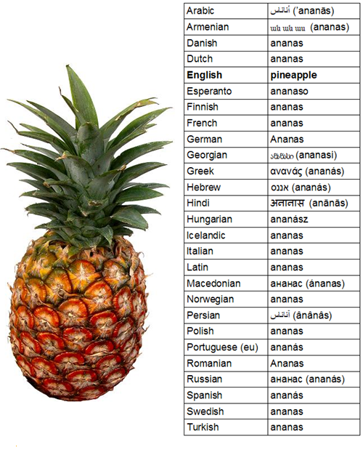
Types of dictionaries
Text dictionaries
Talking dictionaries
Picture dictionaries
http://www.lifeprint.com/dictionary.htm [sign dictionary]
http://ankn.uaf.edu/ANL/course/view.php?id=7

Slide 16
Common dictionary formats
‘Toolbox’ type (‘MDF’):
Language – English dictionary with English finderlist
Organized by headword
Web dictionaries vs. books
http://linguistics.berkeley.edu/~yurok/web/lexicon.html
http://www.pledari.ch/mypledari/
http://203.122.249.186/Lexicons/Burarra/lexicon/mainintro.htm
http://www.trussel.com/kir/dic/dic_a.htm
Notes:
First two are web-designed; second two are print dictionaries put online.

Slide 17
What goes into a dictionary?

Slide 18
Information in a dictionary entry
Lexical/Semantic – about the word and its meaning, how the word relates to other words in the language
Phonological/Phonetic – pronunciation information
Grammatical – paradigm forms, suppletion, gender/class information, etc
Social – usage contexts, register, dialect, etc
Encyclopedic – information about the item in the real world (e.g. how it’s made, where it lives, etc)
Historical – etymology of the word, is it a loan, etc
Source – where the words came from

Slide 19
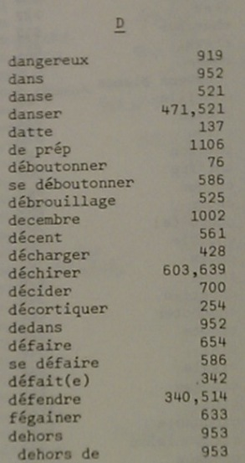
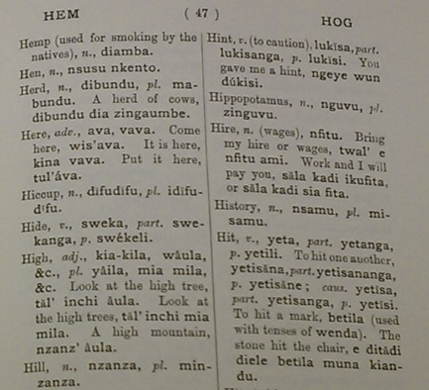
Finderlists
French
Mende

Slide 20
Anatomy of a dictionary entry:

Slide 21
More choices

Slide 22
Headwords
What should the citation form be?
Easy choice in a language without much morphology (where the words don’t change much)
Harder choice if some word parts don’t exist on their own.
eg: Bardi verbs: e.g. -jarrala- ‘run’:
iyarralan ‘he/she is running’
inyjarralagal ‘he/she ran’
nganyjarralagal ‘I ran’
arra oolarrala ‘he/she isn’t running’
irrjarrala ‘they are running’

Slide 23
Headwords
Solution for Bardi: use the third person singular past form, which always shows the full root.
Advantage: Can see the root
Disadvantage: All verbs listed under in- in dictionary
(see also http://sydney.edu.au/arts/linguistics/research/wagiman/dict/dict.html for similar problem in Wagiman)

Slide 24
Headwords
Morphologically related forms?
Often (e.g. in corporate dictionaries):
Inflectional morphology (e.g. singular vs plural) not separate headwords [and not listed] unless
Very different semantics [brother ~ brethren]
Irregular forms [child ~ children; bring ~ brought]
Derivational morphology (e.g. augmentatives, diminutives, etc) not listed unless
Not productive
Accompanied by meaning change
Phrasal compounds
Usually listed (come on, come off, come over, etc)

Slide 25
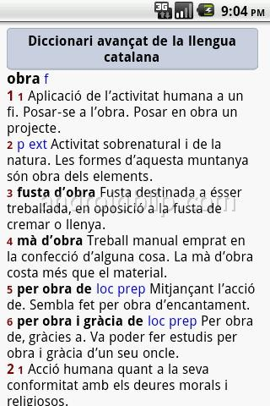
Examples
Headwords vs subentries
Headwords vs ‘return all items’:
http://chamacoco.swarthmore.edu/?fields=all&q=dog

Slide 26
Headwords
What spelling system to use?
Practical orthography?
IPA?
Established orthography?
Guiding principle: what will be most useful to dictionary users.

Slide 27
Ordering of entries
Alphabetical
Easiest for large dictionaries but can be hard for those new to literacy; adult readers often find alphabetical order very unintuitive. (Can be ameliorated by printing the order across the top or bottom of the page.)
Semantic field
Great for browsing,
Good for learners
But can be hard to look up a word (semantic fields are arbitrary; e.g. ‘eat’ under body funtion, food, verb, home, etc?
Notes:
Nb with the Yiddish, it searches text strings without reference to language. That’s a problem for searches like ‘dog’.

Slide 28
(web/e-dictionaries often allow fuzzy searching, making ordering less important)
Example: Mi’kmaq online dictionary: http://www.mikmaqonline.org/
Example 2: Yiddish: http://www.cs.uky.edu/~raphael/yiddish/dictionary.cgi
Root-based sorting (word roots + derivatives)

Slide 29
Dictionary Scope?
How big a dictionary do you plan?
Everything available
What we can do before the money runs out
First draft in 6 months with what we have by then, second draft in 12 months
Launch web site at 500 entries, then continue adding.
Start with plants and animals book, then a series of leaflets on different semantic domains, then combine and expand into dictionary
Compile all words and glosses, then add definitions, examples, etc as possible
…

Slide 30
Words to include/leave out?
Words to include/leave out?
Include everything?
Swear words
Taboo words
words used only by some sections of the community [cf intellectual property rights discussed by Marsha and Alice on Monday]
Loanwords (when does a loan become native?)
bound forms (word pieces)
productively formed words [e.g. compounds]
Idioms
Personal names? Place names? (in Appendix instead?)

Slide 31
How to get words for the dictionary
Method#1 - Produce a list from your own knowledge, or pull some stuff off the web
Method #2 - Use a corpus to check an existing wordlist
Method #3 - Create a wordlist using a corpus
Notes:
We could demo Method #2 during this day.

Slide 32
Getting your own data

Slide 33
Using the DDP/translation equivalents
http://www.sil.org/computing/ddp/DDP_downloads.htm
Set of structured questions in many semantic domains
Designed to be ‘culture-neutral’ (this is good and bad…)
Designed to allow effective brainstorming of vocabulary and example sentences.

Slide 34
Using templates
Templates are checklists of information for a semantic field.
E.g. for a verb:
Is it transitive or intransitive?
Conjugation class, etc
What case marking do the verb’s arguments take?
Can it take a subordinate clause?
What derivational morphology can the verb take? (passive, applicative, etc?) un-, re-
collocations? (words that tend to go together}
Related words

Slide 35
Things to watch out for
examples vs definitions
ranges of term (e.g. English ‘hand’ \neq Bardi ‘nimarl’)
specialized meanings, specialized terminology
polysemy vs homophony (1 word, two meanings vs 2 words, two meanings)

Slide 36
General workflow for getting word data
Every time you come across a new word, ask about it, add it to the dictionary, and include an example from context.
Periodically, go through your data for questions, missing information, etc
Pros:
increases the dictionary size rapidly (at least initially)
allows for common items to emerge early.
Cons:
unsystematic
easy to get only partial information
can interrupt the flow of other work.

Slide 37
Eliciting words for dictionaries
Work by semantic field
Work in small groups, if possible.
Record everything.

Slide 38
Tasks

Slide 39
Task 1: planning entries
How many entries would you create out of this Baonan dataset?

Slide 40
Let’s focus on these:
Is this three entries, two, or one?

Slide 41
One possible solution:
...we might create two entries:
ħɕɵb <n, adj> 1. lie 2. fake. Cf. Amdo Tibetan hɕop. ħɕɵbrɵ habitual liar.
ħɕɵbʨʰa <adj> liar. Cf. Amdo Tibetan hɕofcça .

Slide 42
Task 2
Take a list of ten words and do a corpus search for a couple; use those searches to plan fuller entries.
(Optional: use a couple of the words to think about a template for a semantic field.)

Slide 43
Ways of getting data (not exhaustive!)
pointing at things
translation equivalents
brainstorming words by semantic field
vernacular definitions
using books of pictures
translation equivalents vs discussing meanings with speakers.
can be difficulties in translation in both directions
might want to make this clear in entries
example: Bardi ‘grandmother’ terms;
mother’s mother vs father’s mother
but people are most likely to look up ‘grandmother’ or ‘granny’

Slide 44
Task:
In 5 minutes, come up with as many words for things in the sky as you can (in any language you like).
In the second 5-10 minutes, discuss your list with a partner, compare, see if you can add to it.

Slide 45
Publishing/Sharing a dictionary

Slide 46
Web vs print
Many web dictionaries are just print dictionaries online
http://ieed.ullet.net/tochB.html
Others are fully web-integrated:
www.maoridictionary.co.nz
Content?
Variable exports for different audiences?
Web-to-print or fully web-based?

Slide 47
Issues with web publication
Fonts
http://www.trussel2.com/MOD/ConcordE.htm#eṃṃan (Marshallese dictionary)
(nicely set out and nice use of concordance, but font rendering issues)
Can do things with web publications that can’t be done in print, but many web dictionaries don’t take advantage of this!
(cf Lexique dictionaries)
Sound files:
Ok to play? Size of files? Speed of download?
http://ankn.uaf.edu/ANL/file.php/7/DegXinag.html

