Slide 1
Language Documentation
Week 2: Grammar Writing
Claire Bowern
Yale University
LSA Summer Institute: 2013

Slide 2
semi-structured Elicitation

Slide 3
Brainstorming
e.g. for getting lexicon (particularly material culture) and examples
Tell me about the best things to eat here.
Emotion word elicitation: how would you feel if ..
someone gave you a compliment
someone stepped on your toe
someone ate the food you were saving for dinner
you saw someone you hadn’t seen for a long time
(Great in small groups)

Slide 4
Video clip prompts

Slide 5
put project example

Slide 6
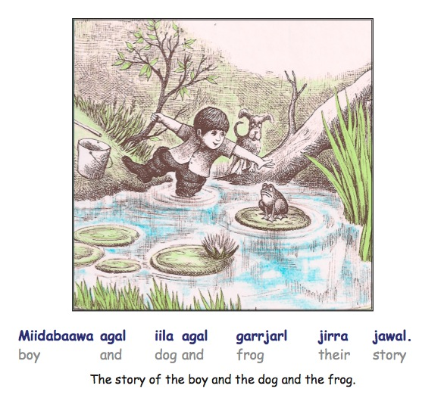
Descriptive tasks
Frog stories

Slide 7
Using props
e.g. deixis
spatial location
(remember to either video your session or have really good notes about the prop configuration!)

Slide 8
Semi-scripted interactions
What would you say if someone woke you up in the middle of the night?
You need to borrow $20 from your cousin, how would you persuade them?
You need to take your daughter to the clinic but your car’s not working; what do you do?
You find out that your auntie is going fishing tomorrow – how would you get her to bring back some fish for you?

Slide 9
Unstructured “Elicitation”

Slide 10
Unstructured elicitation
Oral history project
Personal narratives
Community history
Conversation
Procedural texts
“Ethnophilosophical reasoning”
See week 3 for more discussion

Slide 11
Advantages
Less likelihood of loan translation
Often billed as more ‘naturalistic’ language
Speakers get to record what’s important to them
Great source of cultural knowledge (that is, language as vehicle for other knowledge)
Often valued by community as knowledge repository

Slide 12
Disadvantages
Will need a lot of text before the right constructions come up (in enough frequency to draw conclusions)
Time-consuming to transcribe and translate
Not all speakers might be fluent enough to provide this type of information
Hard to know what you’re getting
Hard to feed directly into cross-linguistic comparison.

Slide 13
Summary

Slide 14
Summary
Different tasks are preferable in different circumstances:
number of speakers available
language competency of the speakers (in both target and contact language)
nature of the task
need of the researcher

Slide 15
Planning elicitation sessions

Slide 16
Recommendation
Spend roughly equal amounts of time on each type of elicitation overall.

Slide 17
Session Length
No more than 2 hours at a time, and that should include one or more breaks
No more than 2 sessions per day with each speaker; less if doing highly demanding work.
(Depends on length of trip, health of speakers, etc)

Slide 18
Planning sessions
Plan at least 3 days ahead, so you have backup material.
Try to do several different tasks in a session.

Slide 19
Planning field trips
Very important to have a rough idea of what you need to accomplish, how much time it’ll take, how best to schedule the tasks across the field trip, etc.
allowing time for checking, re-eliciting, etc
allowing flexibility for changes in plans according to speaker availability, etc.

Slide 20
Planning field trips
Before you leave:
What are your goals of the trip?
Will you have a chance to go back?
(What if you don’t get a chance to go back?)
(What if the same speakers aren’t available next trip?)
Data:
Vital for the project: Critical priority
Important but not crucial: High priority
Would be nice to get sometime but not necessarily this trip: Medium priority
Only if everything else is done: Low priority

Slide 21
Planning field trips: Example
3 month first trip:
Should be able to get at least some data on all main construction types if working regularly.
month 1:
phonology, noun phrases, basic verbal constructions, common phrases, word class evidence, paradigms, lexicon, example sentences, other basic elicitation
month 2:
semi-structured elicitation, more complex elicitation, some textual work.
month 3:
follow-up work on elicitation,
(This is just a suggestion, not set in stone!)

Slide 22
Planning field trips
Keep a diary (aka lab workbook).
It takes some practice to time sessions correctly, and to get a sense of what works and what doesn’t.
Don’t be afraid to try several different techniques.

Slide 23
Grammar writing

Slide 24
Many different types of grammars
pedagogical
monolingual/bilingual
descriptive/prescriptive, etc
Here: bilingual descriptive grammar

Slide 25
Errors in grammar writing
Writing from start to finish (i.e. starting at page one and ending at page …)
Waiting until you’ve returned from the field to write.
Analyzing the English translations rather than the Language sentences (e.g. jimbin translates English ‘under’, so jimbin is a preposition)
Being unwilling to revise (or throw out) analyses.
Presenting the material in the order you discovered it.
Thinking that more data will inevitably solve the problem.

Slide 26
How to start
Compile a table of contents/outline
topics you already have data for
topics that all reference grammars should include (phoneme inventory, phonotactics, word classes, clause types, etc)
Inspiration from
grammars of related languages
other well-written grammars
Collect examples for the sections.
e.g. work through a text collection and cut/paste the examples into the relevant sections of the file.

Slide 27
Good Habits
Write everyday.
Tag your field notes for good examples and collect them periodically.
Keep notes of gaps as you find them.
Insert cross-references as you notice them (good way to work out what’s missing)
Document the sources of your examples.
Start formulating hypotheses as soon as you can.
Keep the files organized! (e.g. one document for each chapter)
Back up every day.
Try to ‘break’ your own analyses.

Slide 28
When you’re stuck
Work out why you’re stuck:
not enough data to decide between hypotheses?
> work out what information you need
no idea about what the sentence means?
> work out which parts of the sentence you understand.
Unsure of the technical term?
> ask, or check grammars
Can’t understand what’s on the recording?
> go through it with a speaker
Still no idea why you’re stuck?
> work on something else for a while

Slide 29
How much ‘theory’
Need to distinguish:
Jargon specific to a particular framework [limits audience, will ‘date’ the grammar]
Ideas which shape the scope of inquiry (e.g. asking a lot of questions about negation scope)
Analytical techniques (e.g. using a lot of grammatical judgments, privileging data from translation)
Theory is vital to language description. There is no such thing as ‘theory neutral’.

Slide 30
Examples?
Each point should be illustrated by one or two examples.
They should be interlinearized and formatted properly, with a free translation.
They should be sourced.
If possible, they should be linked to a recording.
They should appear near the point at which they are discussed in the text.

Slide 31
General features of academic writing
See handout on CTools site

Slide 32
Task:
Use the comparative syntax data on the CTools site to write a grammar fragment.

