Slide 1
Language Documentation
Week 3: Thursday (corpora)
Claire Bowern
Yale University
LSA Summer Institute: 2013

Slide 2
Unstructured data gathering
planned and unplanned speech
one speaker vs conversation
genre

Slide 3
What counts as a ‘text’?
Descriptions of events or objects
Reminiscences
Proverbs
Translations of stories
Speeches, oratory
Jokes
Insult games
Written genres of many forms…
…

Slide 4
‘Eliciting’ stories
“Tell me a story” sometimes works, but it’s rare.
Try recording in an environment where stories would naturally be told
(problem: these are seldom good environments for recordings; car trips, pubs, etc)
Quasi-interview techniques (encouraging speakers to talk)
Story workshops:
  cf. Dickinson (2007): The Tsafiki Text Factory (training native speakers in Tsafiki literacy, providing computers and some writing suggestions; very effective for generating language materials

Slide 5
Corpora

Slide 6
What is a ‘corpus’
A collection of speech samples in context.
Raw text or annotated
  samples in context: your translations or example sentences are not (strictly) a corpus.

Slide 7
Why build a corpus?
Searchable resource for grammatical examples.
Can uncover points that can be tested (example: Bardi adjective ordering)
Feeds into reclamation programs (not much point learning to read if there’s nothing to read in the language)

Slide 8
Corpus planning
Target number of texts or words
How many genres?
How many speakers?
How many dialects/varieties?
Repeat stories from different speakers?

Slide 9
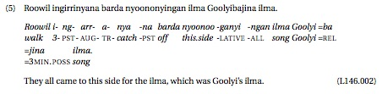

Editing texts
how much to edit?
presenting an accurate (word by word) transcript vs preparing a “clean” text.
  Transferring speech to text as genre consequences, even for unwritten languages.
How much to interlinearise?

Slide 10
Format?
Buzzard-Welcher (2007):
  Working format
  Presentation format
  Archival format

Slide 11
Working format
Toolbox
plain text
Elan
Need to be able to search:
  for words
  for morphemes
  ideally, for patterns (e.g. search for part of speech to find Noun phrase examples)
  Toolbox interlinearisation is a work-around for part of speech tagging.
  Relative frequencies in sub-parts of the corpus
For tagging:
  http://www.cis.upenn.edu/~treebank/

Slide 12
Presenting a corpus
Web
  In book form for download
  as web site
Book
  community-printed
  university press
  self-printed (e.g. http://www.lulu.com/)

Slide 13
Web: CuPed example
Works on Elan files
Can export audio or video
http://sweet.artsrn.ualberta.ca/cdcox/cuped/
Example: http://sweet.artsrn.ualberta.ca/cdcox/cuped/examples/Plautdietsch-Martha_Klassen-Aupelkoose/web/index.html
http://archive.org/details/HowToEatABanana
http://www.lakotabears.com/
(Other web presentations are print presentations formatted in html)

Slide 14
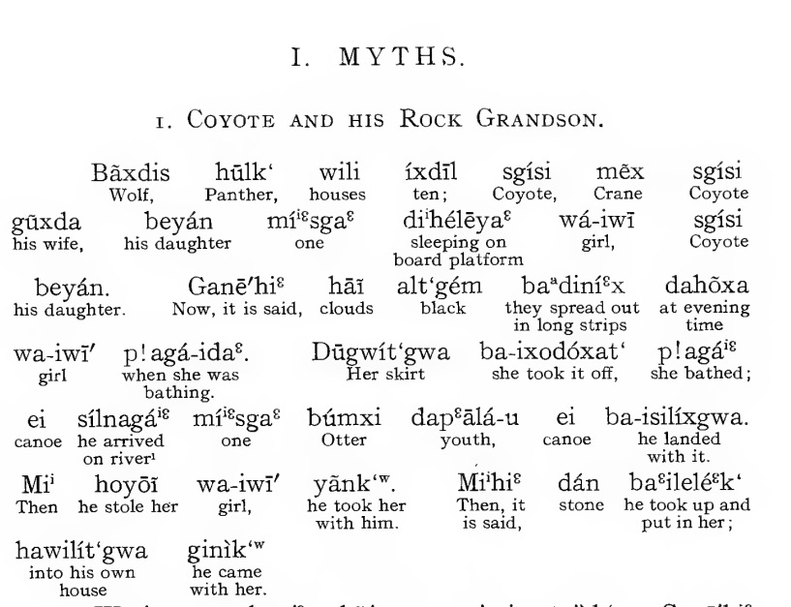
Sapir: Takelma texts

Slide 15
Issues in text presentation
Who’s going to read them?
Interlinear vs two-column
Free translation?
How much annotation?

Slide 16
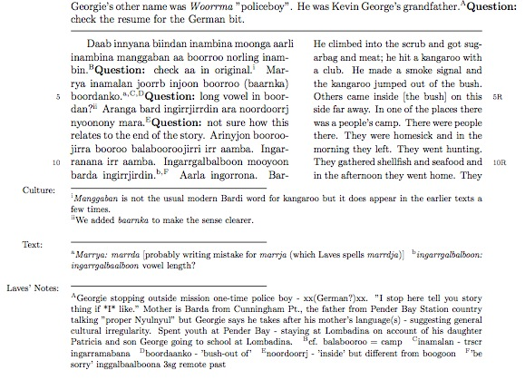

Slide 17
Conversations
Why record conversational data?
  Different array of constructions from other types of data.
  Cross-linguistic studies of interaction
    Turn-taking?
    Gricean maxims?
    Licitness of pauses
  How aspects of language are used
    e.g. how people use names
  Repair strategies
  Useful in language reclamation programs
  Studying accommodation

Slide 18
Manufacturing discourse data
e.g. Map tasks: http://groups.inf.ed.ac.uk/maptask/
Role-plays
(other tasks as discussed last week)
Language games; I spy, etc.
  See Meakins’ optional reading for examples

Slide 19
‘Adding value’ to texts
Many old sources are only partially documented.
Who can tell this story?
What’s it about?
Language differences

Slide 20
Example: Laves

